Slide 1
CHILD SOLDIERS
CREATED BY:
E. WALSH OCTOBER 2ND, 2014

Slide 2
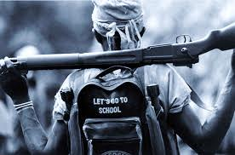
It is estimated that approximately 300,000 children are involved in armed conflict in over 30 countries.

Slide 3
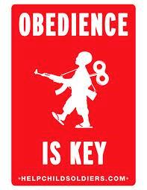
Many children are forced to kill their families upon being kidnapped.

Slide 4
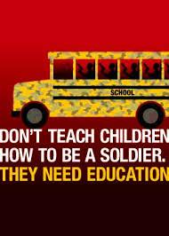
ALL children have the right to an education.
YET child soldiers are used not only as fighters, many are forced into providing sexual services.

Slide 5

HOWEVER, we can make a difference.
Create a website to inform people about the horrific abuse suffered by child soldiers.

Slide 6

CONTACT your M.P. and M.H.A.
Demand that Canada be part of the solution.

Slide 7

BE THE CHANGE.
Spread the word in your school.

Slide 8
Recommendation
www.dosomething.org/facts/11-facts-about-child-soldiers is the site I would recommend. It is easy to use and it provides clear and concise facts.

Slide 9
The use of child soldiers is illegal and immoral. Children should enjoy their childhoods, not be forced into participating in armed conflicts.

Slide 10
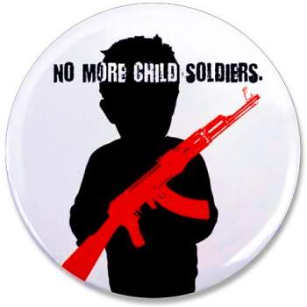
TOGETHER, we can make a difference in the lives of child soldiers.

Slide 11
credits
http://en.wikipedia.org/wiki/Child_Soldiers_International
http://http://theinspirationroom.com/daily/2009/help-child-soldiers/
http://www.posterfortomorrow.org/en/gallery/competitions/the_right_to_education/sort/views
http://www.smcdsb.on.ca/students/beyond_the_classroom
https://www.flickr.com/photos/29970899@N06/3255235635/
www.dosomething.org/facts/11-facts-about-child-soldiers
www.unicef.org/emerg/files/childsoldiers.pdf

